Slide 1
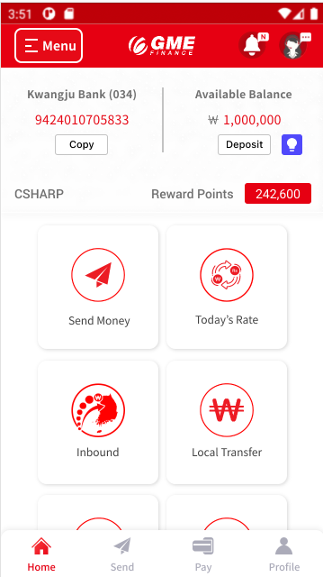


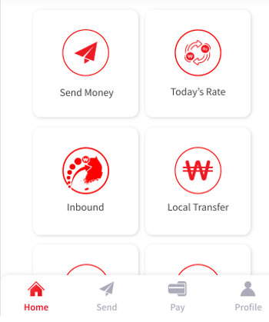

Automatically running Carousel
Automatically running Carousel
Invite a friend
Refer a friend
Spin the Wheel

Slide 2
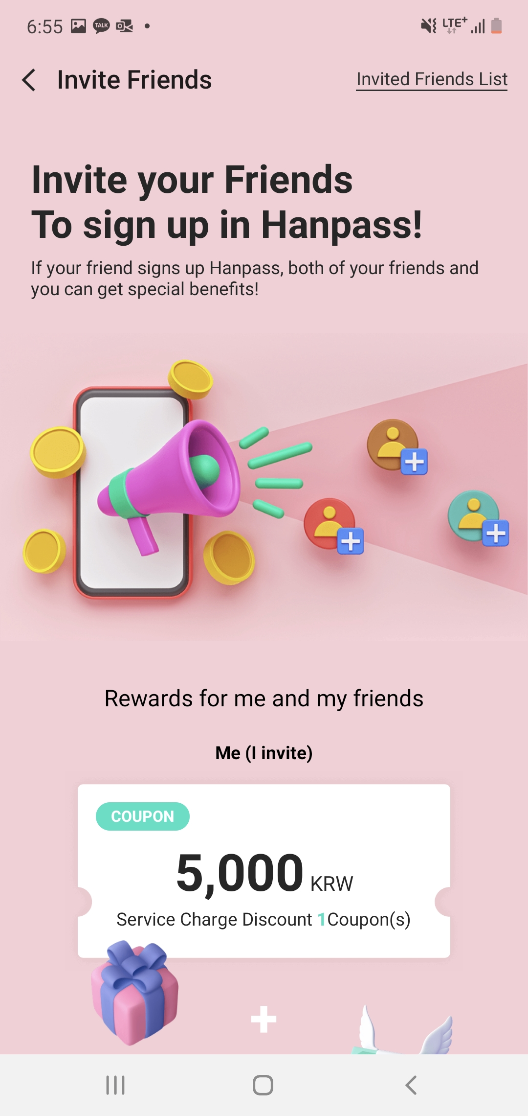
Invite your Friends
To Join GME
Number of Friends you’ve invited:
11
You and your friend will get special rewards after your friend successfully registers for GME.
Munkhbileg Sundariya waiting
Subash Poudel 22/03/07 17:11
Rajesh Poudel 22/03/05 15:13
Invite a friend
Invite a friend
Invite a friend

Slide 3
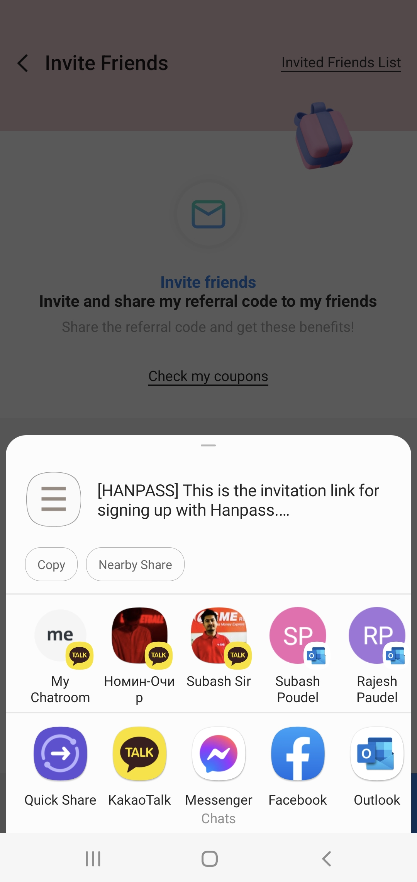
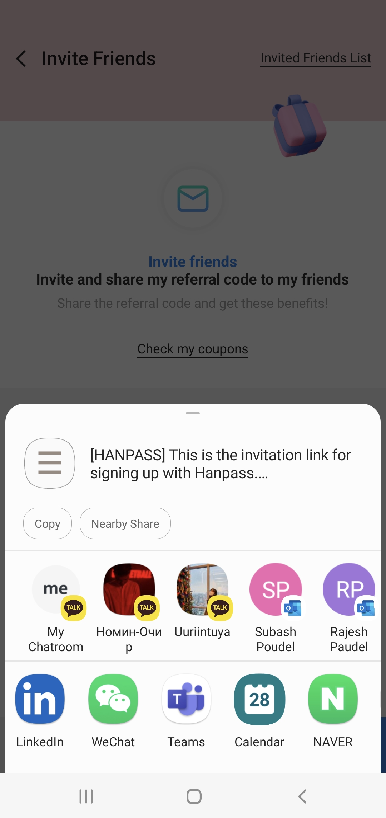
Number of Friends you’ve invited:
11
Munkhbileg Sundariya waiting
Subash Poudel 22/03/07 17:11
Rajesh Poudel 22/03/05 15:13
[GME] This is the invitation link for registering GME.
[GME] This is the invitation link for registering GME.
Should be able to scroll to right side for more apps
(mostly used apps show on left-most)
Invite a friend

Slide 4
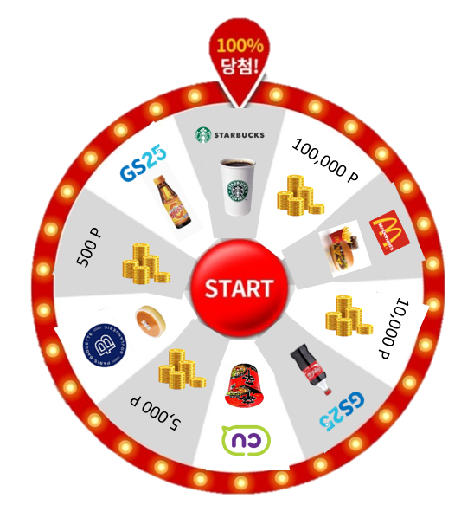


Spin the Wheel and
Win 100,000 point
Share with a friend,
Get more chances to spin the wheel.
If friend who received the link:
Registers GME and send overseas transaction-> 5 chances to spin the wheel
Sends overseas transaction (in case of existing GME customer) -> 2 chances to spin the wheel
Registers GME and spin the wheel -> 1 more chance to spin the wheel
Refer a friend
Spin the Wheel
Share with a friend
Winners:
100,000 point 10 people
10,000 point 1,000 people
Starbucks coupon 25,700 people
Wheel will be bought from 3rd party
Refer to:
https://www.easypromosapp.com/
Share with a friend
Share with a friend

Slide 5
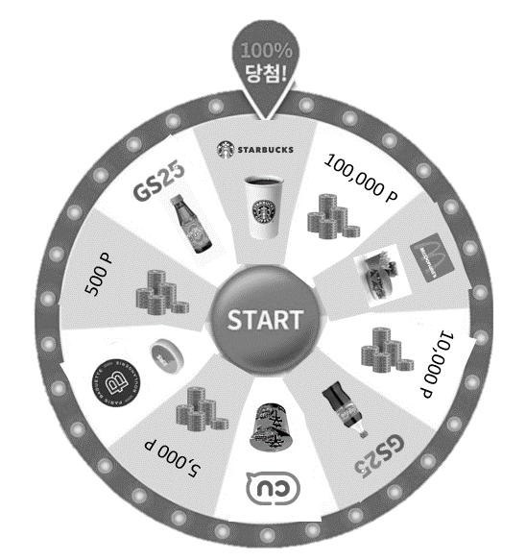
Spin the Wheel and
Win 100,000 point
Share with a friend,
Get more chances to spin the wheel.
If friend who received the link:
Registers GME and send overseas transaction-> 5 chances to spin the wheel
Sends overseas transaction (in case of existing GME customer) -> 2 chances to spin the wheel
Registers GME and spin the wheel -> 1 more chance to spin the wheel
Refer a friend
Spin the Wheel
Share with a friend,
Get more chances to spin the wheel.
Share with a friend
Winners:
100,000 point 10 people
10,000 point 1,000 people
Starbucks coupon 25,700 people
Share with a friend
Share with a friend

Slide 6
Spin the Wheel and
Win 100,000 point
Share with a friend,
Get more chances to spin the wheel.
[GME] This is the invitation link for registering GME.
[GME] This is the invitation link for registering GME.
Should be able to scroll to right side for more apps
(mostly used apps show on left-most)
Share with a friend

Slide 7

Invite a friend
Invite a friend
Spin the Wheel
Mongolia: International Women’s day Promotion

